Slide 1

Lecture 5 Conditional Structures & loops

Slide 2
Java - Decision Making
Decision making structures have one or more conditions to be tested by the program,
Along with a statement or statements that are to be executed if the condition is determined to be true,
Optionally, other statements to be executed if the condition is determined to be false.

Slide 3
types of decision making statements.
if statement
If…else statement
Nested if else statement
Else..if ladder
Switch statement

Slide 4
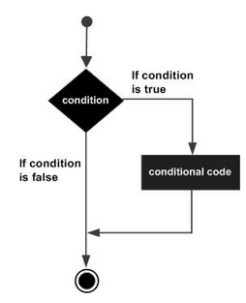
If.. statement
An if statement consists of a Boolean expression followed by one or more statements.
if(Boolean_expression)
{
// Statements will execute if the Boolean expression is true
}

Slide 5
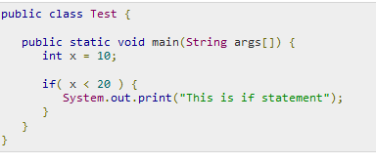

Example

Slide 6
Read age of user and make a decision to print whether age is less than 21 print “ youth is wonderful” otherwise print “ Age is state of mind”
If (age<21)
System.out.println(“ YOUTH IS WONDERFUL”);
System.out.println(“AGE IS STATE OF MIND”);

Slide 7
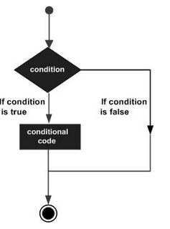

If – else statement
if(Boolean_expression)
{
// Statements will execute if the Boolean expression is true
}
Else
{
// Statements will execute if the Boolean expression is fasle
}

Slide 8
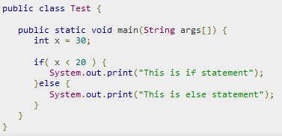
Example

Slide 9
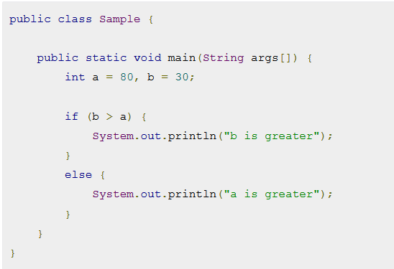
Example

Slide 10
Check input number is odd or even | Even → no %2 ==0 Odd → no%2 !=0 | if ( no%2 ==0) { } else { }
Comparison between two numbers | < , <=, >, >=, == ,!= | if (a <b) if(a>b) if( a<=b) if(a>=b) if( a==b) if (a!=b)
Two conditions |  | if ( no>0 && no<10) if ( no==5 || no==10) if(a>b && a>c)

Slide 11
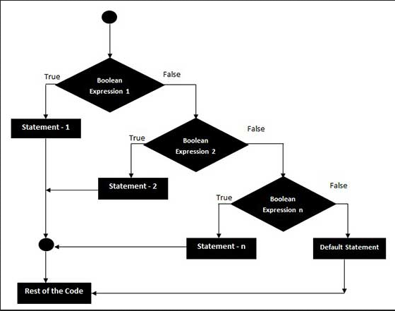
Else…if
very useful to test various conditions using single if...else if statement.

Slide 12
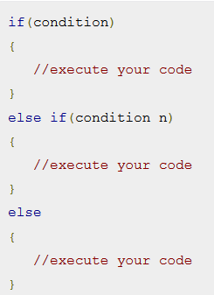
Syntax

Slide 13
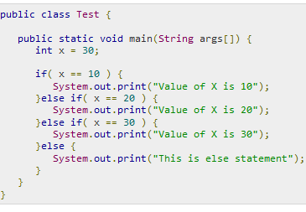
Example

Slide 14
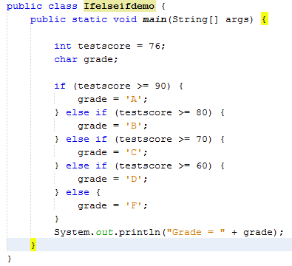
Example

Slide 15
Exercise
Consider the following code snippet.
if (aNumber >= 0)
if (aNumber == 0)
System.out.println("first string");
else
System.out.println("second string");
System.out.println("third string");
What output do you think the code will produce if aNumber is 3?

Slide 16
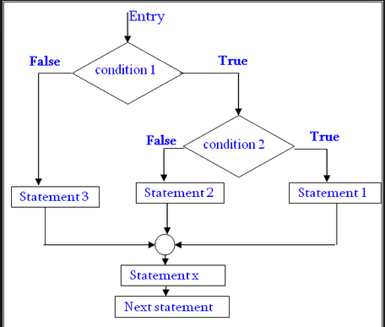
Nested if statements

Slide 17
If (Boolean_expression 1)
{
// Executes when the Boolean expression 1 is true
if(Boolean_expression 2)
{
// Executes when the Boolean expression 2 is true
}
else
{
// Executes when the Boolean expression 2 is false
}
}
else
{
}

Slide 18
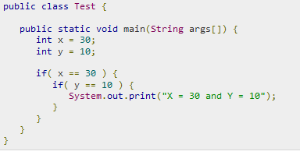

Example

Slide 19
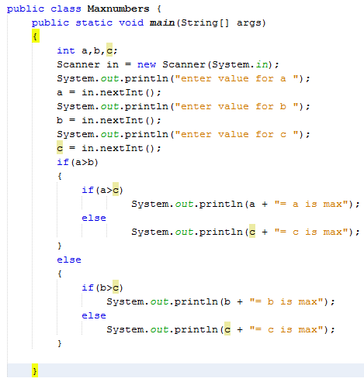
Find the maximum number out of 3 numbers

Slide 20
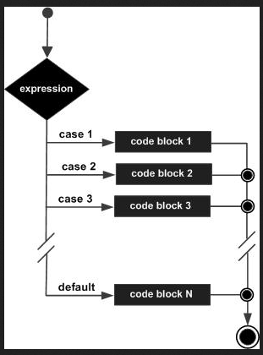
Switch Structure
Its used when you have multiple possibilities for the if statement

Slide 21
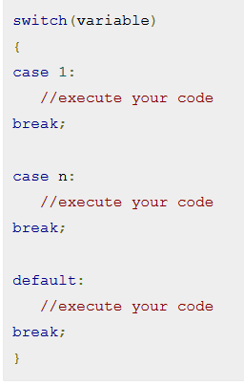
Syntax

Slide 22
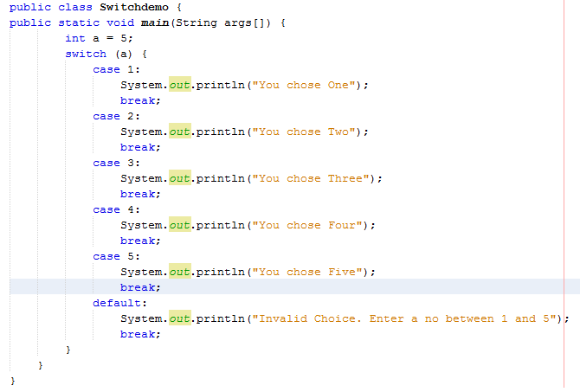
Example

Slide 23
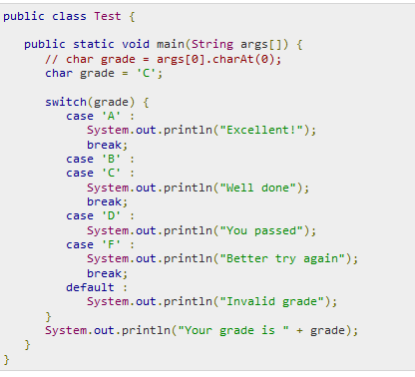
Example

Slide 24
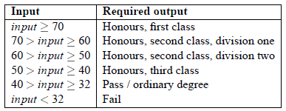
Exercises
Declare an int named month whose value represents a month. The code displays the name of the month, based on the value of month
write a program called DegreeCategory which takes a student mark (e.g. final year, total assessment mark) and reports what degree category it is worth. The input is a single number.

Slide 25
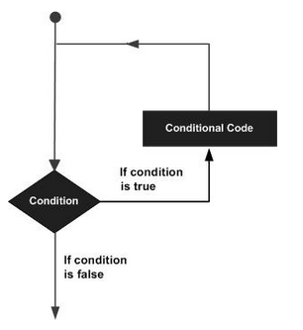
Loop Control
There may be a situation when you need to execute a block of code several number of times.
A loop statement allows us to execute a statement or group of statements multiple time

Slide 26
Types of loop
While loop
Do..while loop
For loop

Slide 27
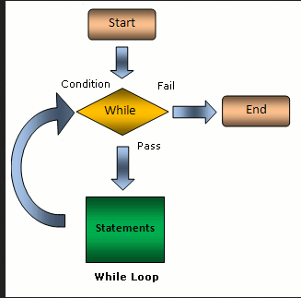
While
In while loop first check the condition
if condition is true
then control goes inside the loop body
otherwise goes outside of the body

Slide 28
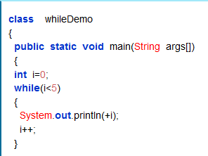

Syntax
while(condition)
{
Statement(s);
Increment / decrements (++ or --);
}

Slide 29
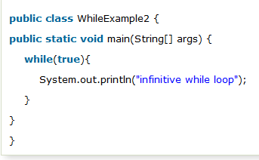
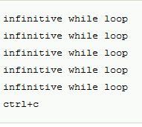
Java Infinitive While Loop
If you pass true in the while loop, it will be infinitive while loop

Slide 30
Review Questions
What is the output of the following code?
b = 1;
while(b < 4)
System.out.print(b + " ");
a. 1
b. 1 2 3
c. 1 2 3 4
d. 1 1 1 1 1 1…

Slide 31
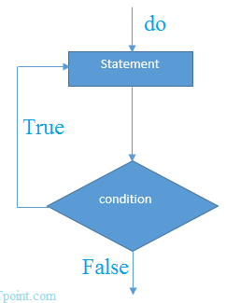
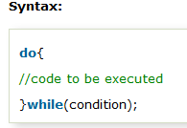
Do..while loop
Used to iterate a part of the program several times.
If the number of iteration is not fixed and you must have to execute the loop at least once, it is recommended to use do-while loop.

Slide 32
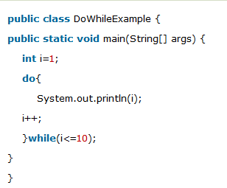

Example

Slide 33
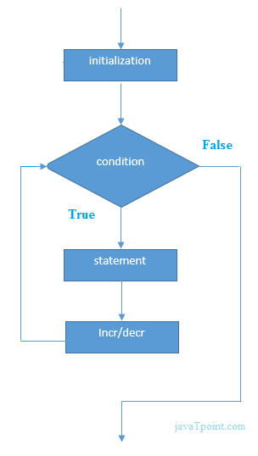
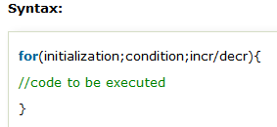
For loop
used to iterate a part of the program several times.
If the number of iteration is fixed,
it is recommended to use for loop.

Slide 34

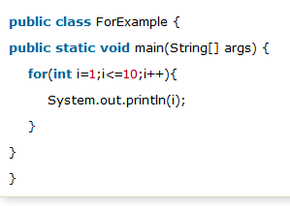
Example

Slide 35
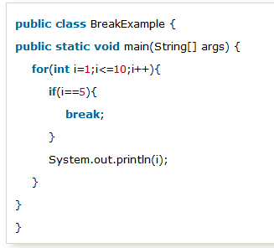

Java Break Statement
used to break loop or switch statement.
It breaks the current flow of the program at specified condition.

Slide 36
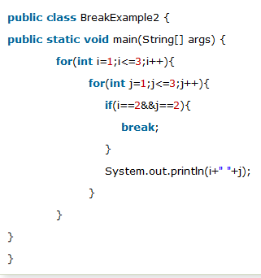

Java Break Statement with Inner Loop
It breaks inner loop only if you use break statement inside the inner loop.

Slide 37

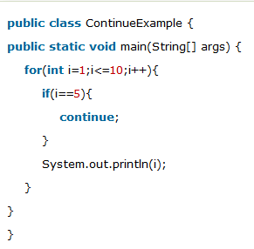
Java Continue Statement
Used to continue loop.
It continues the current flow of the program and skips the remaining code at specified condition

Slide 38
What does the following statement output?
for(b = 1; b > 3; ++b)
System.out.print(b + " ");
a. 1 1 1
b. 1 2 3
c. 1 2 3 4
d. Nothing

Slide 39
Programming Exercise
Write a java program to find factorial of a number
Input: 5
Output: 120
Input: 6
Output: 720
Write a java program to check prime number.
Input: 44
Output: not prime number
Input: 7
Output: prime number

Slide 40
Programming Exercise
Write an application that displays all even numbers from 2 to 100 inclusive, and that starts a new line after every multiple of 20 (20, 40, 60, and 80). Save the file as EvenNums.java.
Write an application that asks a user to type 1, 2, 3, or 4. When the user types 4, the program ends. When the user types 1, 2, or 3, the program displays the message “Good
job!” and then asks for another input. When the user types anything else, the application issues an error message and then asks for another input. Save the file as Input123.java.

